Slide 1
AZ-900T0x Module 02: Core Azure services
Notes:
Adjust the cover for either AZ-900T00 or AZ-900T01.

Slide 2
Geographies
Discrete markets that preserve data residency and compliance boundaries.
Typically contain two or more regions.
Allow customers with specific data-residency and compliance needs to keep their data and applications in close proximity.
Categorized as Americas, Europe, Asia Pacific, Middle East, and Africa.
Notes:
A list of geography locations is available at : https://azure.microsoft.com/en-us/global-infrastructure/geographies/

Slide 3
Regions
A region represents a collection of datacenters. You don’t see individual data centers.
Preserves data residency.
Select regions close to your users.
Be aware of region deployment availability.
There are global services that are region independent.
Worldwide there are 54 regions representing 140 countries
Notes:
REGIONS: https://azure.microsoft.com/en-us/global-infrastructure/regions/
CONNECTIONS: https://azure.microsoft.com/en-us/global-infrastructure/global-network/
Over a Petabit per second in some locations!
From slide:
* Provides flexibility and scale.
Microsoft Azure has more global regions than any other cloud provider. This provides customers the flexibility and scale needed to bring applications closer to users around the world, preserving data residency and offering comprehensive compliance and resiliency options for customer. At the time of writing this, Azure is generally available in 42 regions around the world, with plans announced for 12 additional regions.
Special Azure regions
Special regions include:
US DoD Central, US Gov Virginia, US Gov Iowa and more in the US. These are physical and logical network-isolated instances of Azure for US government agencies and partners. They are operated by screened US personnel. Includes additional compliance certifications.
China East, China North, and more in China. These regions are available through a unique partnership between Microsoft and 21Vianet, whereby Microsoft does not directly maintain the datacenters.
Germany Central and Germany Northeast. These regions are available through a data trustee model whereby customer data remains in Germany under control of T-Systems, a Deutsche Telekom company.

Slide 4
Region Pairs
Each Azure region is paired with another region.
Azure prefers at least 300 miles of separation between datacenters in a regional pair. Think: flood zones, hurricane zones, electrical grids.
Some services provide automatic replication to the paired region.
In an outage, recovery of one region is prioritized out of every pair.
Azure system updates are rolled out to paired regions sequentially (not at the same time).
Paired regions are members of the same geography – except Brazil.
Region
North Central US​
East US​
West US 2​
US East 2​
Canada Central​
North Europe​
UK West​
Germany Central​
South East Asia​
East China​
Japan East​
Australia Southeast​
India South​
Brazil South (Primary)​
Region
South Central US​
West US​
West Central US​
Central US​
Canada East​
West Europe​
UK South​
Germany Northeast​
East Asia​
North China​
Japan West​
Australia East​
India Central​
South Central US ​
Notes:
A full list of region pairs is available at https://docs.microsoft.com/en-us/azure/best-practices-availability-paired-regions#what-are-paired-regions

Slide 5
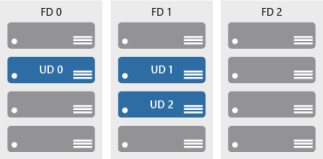

Availability zones
Azure Region
Physically separate locations within an Azure region.
Takes availability sets to the next level
Includes one or more datacenters, equipped with independent power, cooling, and networking.
Acts as an isolation boundary.
If one availability zone goes down, the other continues working.
Availability Zone 1
Availability Zone 2
Availability Zone 3
Notes:
More details about Availability Zones in Azure are available at https://docs.microsoft.com/en-us/azure/availability-zones/az-overview

Slide 6


Slide 7
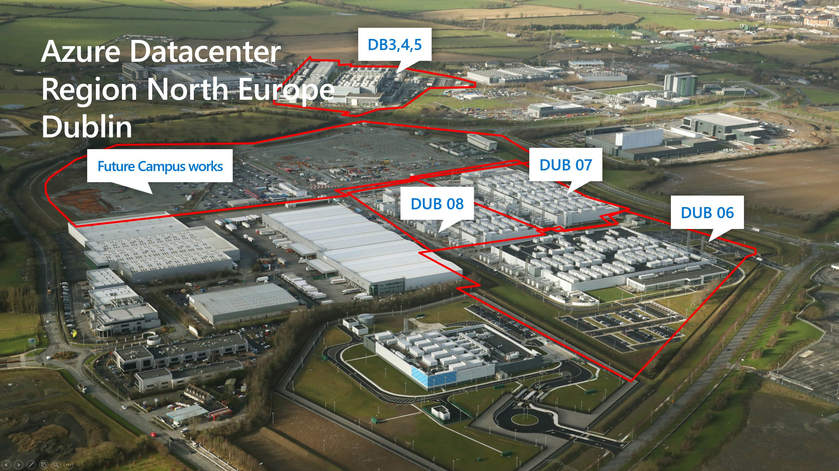

Slide 8
Availability sets
Keep applications online during maintenance or hardware failure.
Update domains (UD): Scheduled maintenance, performance or security updates are sequenced through update domains.
Fault domains (FD): Provide a physical separation of workloads across different hardware in a datacenter.

Slide 9
Availability Options
VM SLA
VM SLA
VM SLA
MULTI-REGION DISASTER RECOVERY
99.9% with Premium Storage
99.95%
99.99%
Region 1
Region 2
SINGLE VM
AVAILABILITY SETS
AVAILABILITY ZONES
REGION PAIRS
Easier lift and shift
Protecting against failures within datacenters
Protection from entire datacenter failures
Regional protection within Data Residency Boundaries
Notes:
This slide is to introduce the upcoming topics. You could also use the slide at the end of the lesson to review.

